Slide 1
Breakdown of current insights from Digital Explorer
David Stevens August 2018

Slide 2
All the demand reports here can be run directly within the DE Platform
https://digitalexplorer.dxc.com/bvr/insights

Slide 3
Contents
Demand from Innovation Agendas
Top 10 trends
Top 10 focus trends
Top 10 Strategic Trends
Top trends within delivered solutions
Backup slides include breakdown for each section by industry and or region

Slide 4
Note on the dataset
Digital Explorer is still being rolled out across DXC, a number of regions have not yet included their innovation agendas within the platform.
Region | Number of Innovation Agendas
AMS | 32
ANZ | 0
Asia | 0
N & C Europe | 17
S Europe | 0
UKIIMEA | 24

Slide 5
Life of a Trend
Catalogue of Trends
Innovation Agenda
Innovation Agenda
Strategic Initiative
Solutions
T
T
T
T
T
T
T
T
T
T
T
T
T
T
T
T
T
T
T
T
T
T
T
T
T
T
T
T
T
T
T
Accounts select relevant trends for their innovation agendas
Refine relevant trends down to focus areas
Map focus areas to Account Strategic Initiatives
Initiatives become Solutions which deliver against the trend

Slide 6
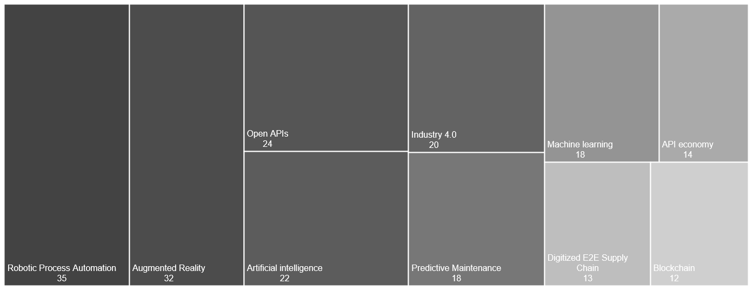
Demand Signals These represent the selection of a business or technology trend referenced within a client innovation agenda.
Notes:
match (i:Industry)--(si:SubIndustry)--(a:Account)--(ia:InnovationAgenda)--(cvc:ClientValueChain)--(cd:ClientDisruptor)-[:SPECIALIZES]->(trend)
return trend.name, count(trend) order by count(trend) desc
limit 10

Slide 7
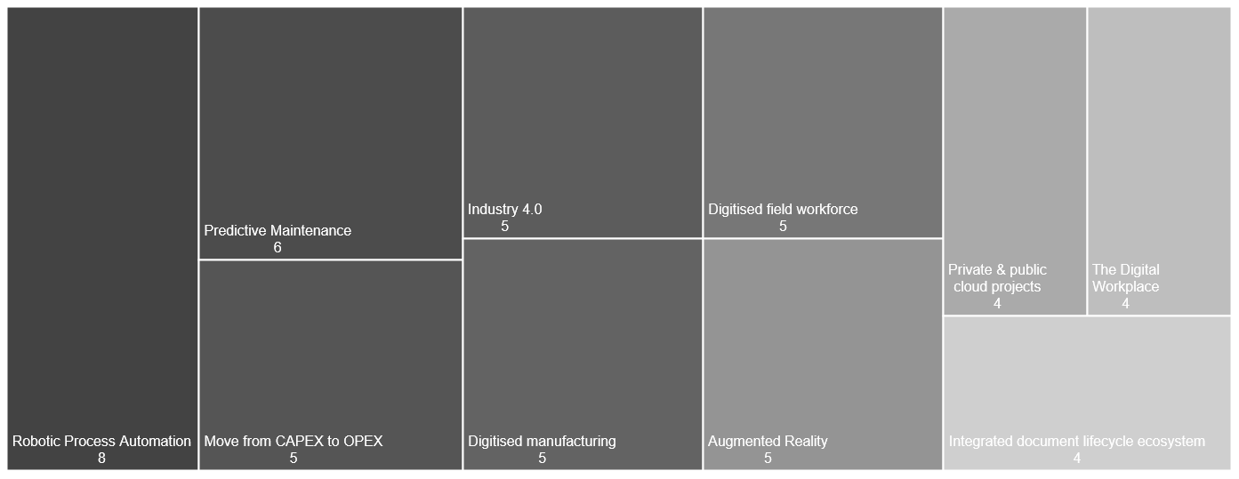
Top 10 focus areas within Innovation Agendas These represent the selection of a business or technology trends referenced within a client innovation agenda which have been identified by the account as a focus area for the next 6-12 months
Notes:
//count of disruptors for a region
match (cd:ClientDisruptor)-[:SPECIALIZES]->(trend)
where cd.focusArea = true
return trend.name, count(trend) order by count(trend) desc
LIMIT 10

Slide 8
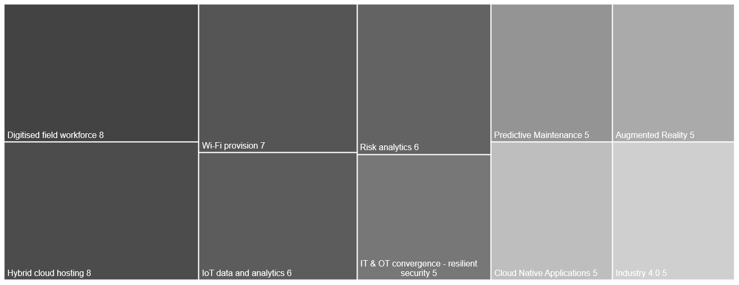
Top trends within Strategic Initiatives Focus areas pulled into committed Account & Client Strategic Initiatives (i.e. entries within SFDC)
Notes:
match (r:Region)--(a:Account)--(ia:InnovationAgenda)--(cvc:ClientValueChain)--(cd:ClientDisruptor)--(csi:ClientStrategicInitiative),
(cd)-[:SPECIALIZES]-(trend)
return distinct r.name,a.name,csi.name,csi.description, cd.name,trend.name

Slide 9
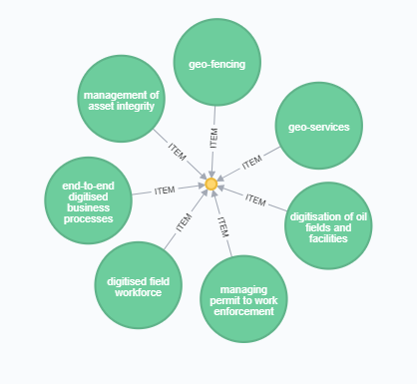
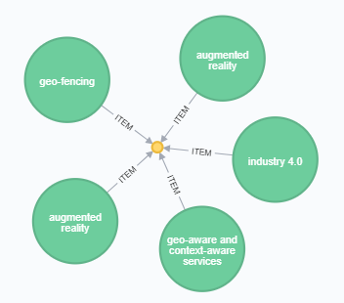
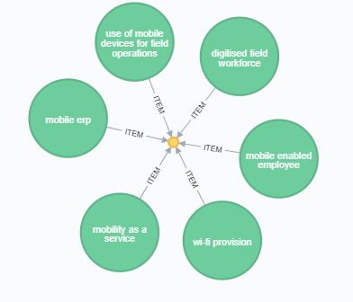
Clusters of key trends Trend patterns within Strategic Initiatives
Notes:
MATCH (csi:ClientStrategicInitiative)-[]->(:ClientDisruptor)-[:SPECIALIZES]->(trend)
WITH count(DISTINCT csi) AS total
MATCH (csi:ClientStrategicInitiative)-[]->(cd:ClientDisruptor)-[:SPECIALIZES]->(trend)
WITH csi, collect(trend.name) AS col, total
RETURN col, toFloat(count(col))/toFloat(total) *100 as frequency
ORDER BY frequency DESC

Slide 10
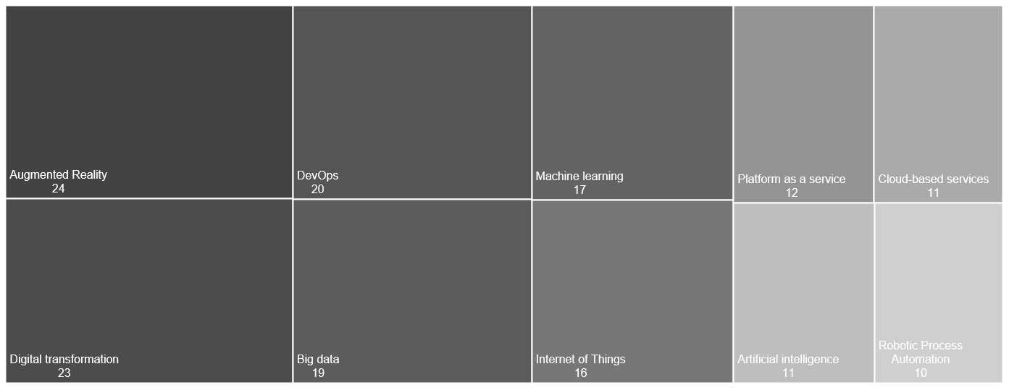
Top trends within delivered solutions These represent the business or technology trends referenced within documented DXC Solutions
Notes:
match (trend)
where trend:BusinessTrend or trend:TechnologyTrend
with trend
match (trend)-[:INFLUENCE]-(s:Solution)
return distinct trend.name, count(trend) as counter order by counter DESC
limit 10

Slide 11
BACKUP SLIDES
DETAILED BREAKDOWN OF EACH HEATMAP BY REGION AND INDUSTRIES

Slide 12
The Industries & Regions Aligns with DXC corporate taxonomy
Banking & Capital Markets
Communications, Media & Entertainment
Consumer Industries & Retail
Energy
Healthcare & Life Sciences
Insurance
Manufacturing
Public Sector
Travel & Transportation
AMS
ANZ
Asia
N & C Europe
S Europe
UKIIMEA

Slide 13
Demand Signals by Industry

Slide 14
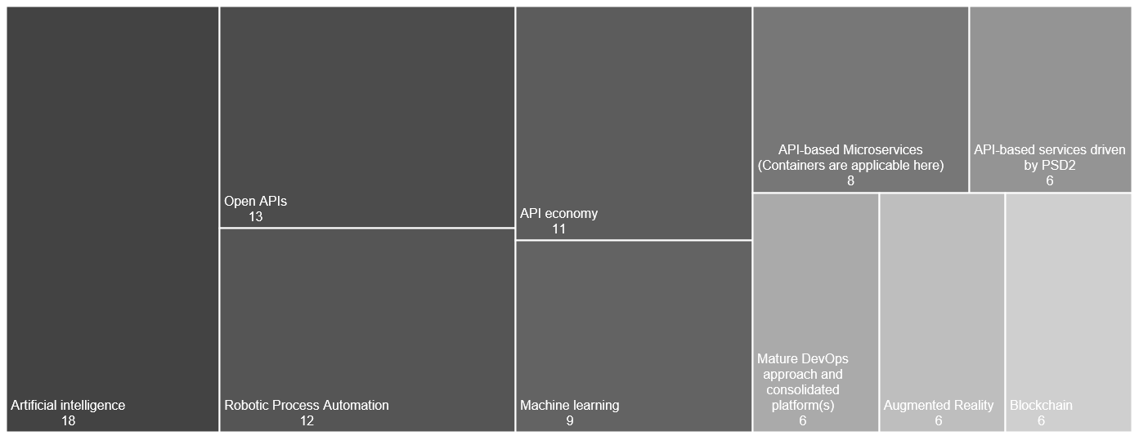
Top 10 trends within Innovation Agendas Banking & Capital Markets
Notes:
//count of disruptors for an industry
match (i:Industry)--(si:SubIndustry)--( a:Account)--(ia:InnovationAgenda)--(cvc:ClientValueChain)--(cd:ClientDisruptor)-[:SPECIALIZES]->(trend)
where i.name='Banking & Capital Markets'
return trend.name, count(trend) order by count(trend) desc
limit 10

Slide 15
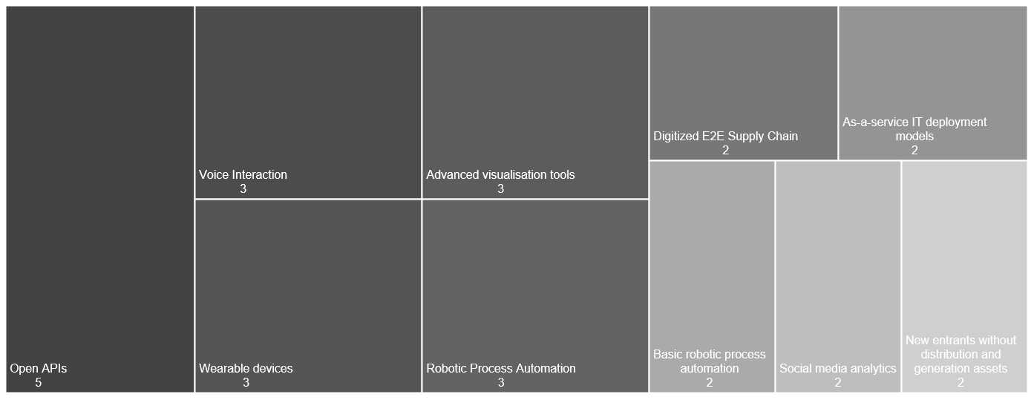
Top 10 trends within Innovation Agendas Communications, Media & Entertainment
Notes:
//count of disruptors for an industry
match (i:Industry)--(si:SubIndustry)--( a:Account)--(ia:InnovationAgenda)--(cvc:ClientValueChain)--(cd:ClientDisruptor)-[:SPECIALIZES]->(trend)
where i.name='Communications, Media & Entertainment'
return trend.name, count(trend) order by count(trend) desc
limit 10

Slide 16
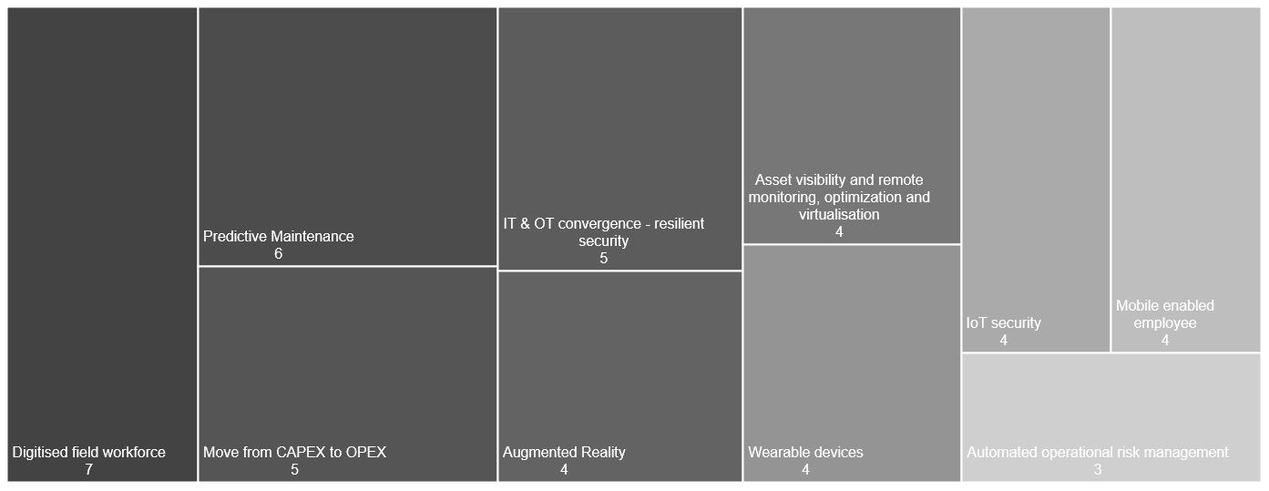
Top 10 trends within Innovation Agendas Energy
Notes:
//count of disruptors for an industry
match (i:Industry)--(si:SubIndustry)--( a:Account)--(ia:InnovationAgenda)--(cvc:ClientValueChain)--(cd:ClientDisruptor)-[:SPECIALIZES]->(trend)
where i.name='Energy'
return trend.name, count(trend) order by count(trend) desc
limit 10

Slide 17
Top 10 trends within Innovation Agendas Healthcare & Life Sciences
NO DATA
Notes:
//count of disruptors for an industry
match (i:Industry)--(si:SubIndustry)--( a:Account)--(ia:InnovationAgenda)--(cvc:ClientValueChain)--(cd:ClientDisruptor)-[:SPECIALIZES]->(trend)
where i.name='Healthcare & Life Sciences'
return trend.name, count(trend) order by count(trend) desc
limit 10

Slide 18
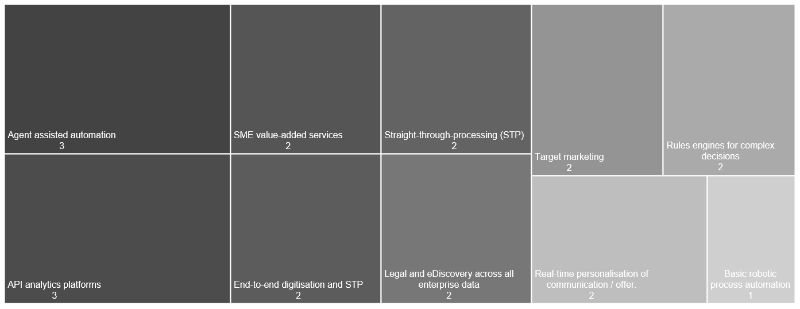
Top 10 trends within Innovation Agendas Insurance
Notes:
//count of disruptors for an industry
match (i:Industry)--(si:SubIndustry)--( a:Account)--(ia:InnovationAgenda)--(cvc:ClientValueChain)--(cd:ClientDisruptor)-[:SPECIALIZES]->(trend)
where i.name='Insurance'
return trend.name, count(trend) order by count(trend) desc
limit 10

Slide 19
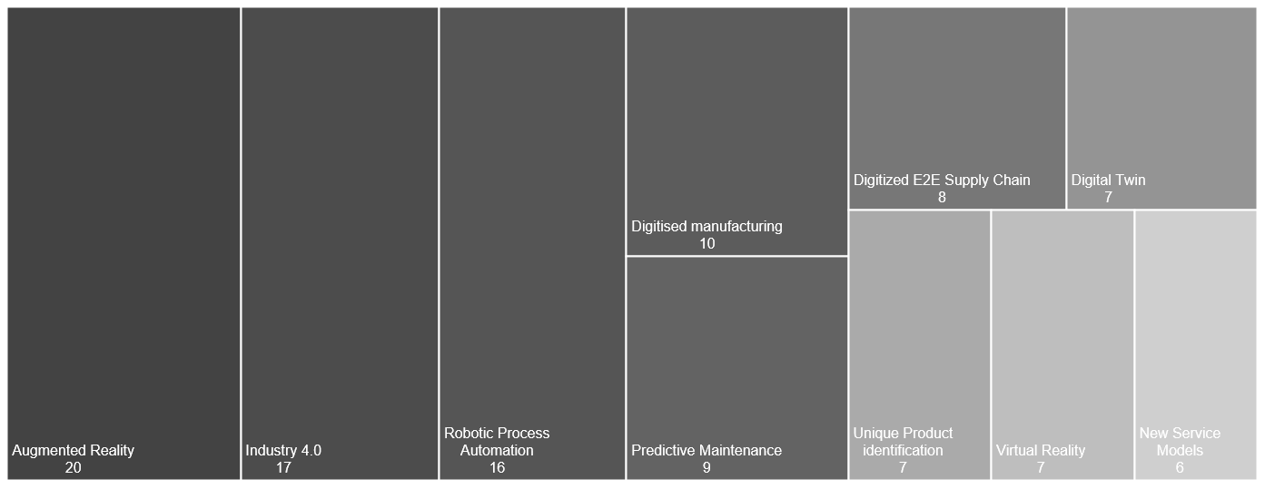
Top 10 trends within Innovation Agendas Manufacturing
Notes:
//count of disruptors for an industry
match (i:Industry)--(si:SubIndustry)--( a:Account)--(ia:InnovationAgenda)--(cvc:ClientValueChain)--(cd:ClientDisruptor)-[:SPECIALIZES]->(trend)
where i.name='Manufacturing'
return trend.name, count(trend) order by count(trend) desc
limit 10

Slide 20
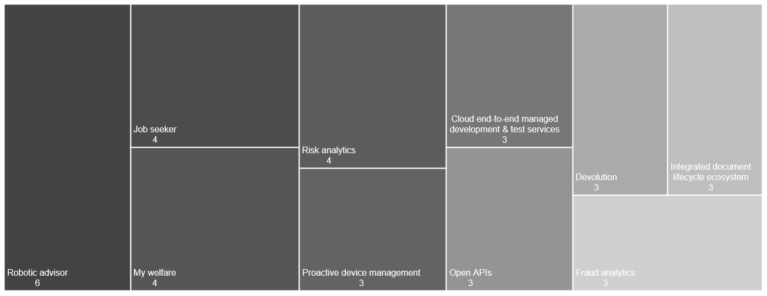
Top 10 trends within Innovation Agendas Public Sector
Notes:
//count of disruptors for an industry
match (i:Industry)--(si:SubIndustry)--( a:Account)--(ia:InnovationAgenda)--(cvc:ClientValueChain)--(cd:ClientDisruptor)-[:SPECIALIZES]->(trend)
where i.name='Public Sector'
return trend.name, count(trend) order by count(trend) desc
limit 10

Slide 21
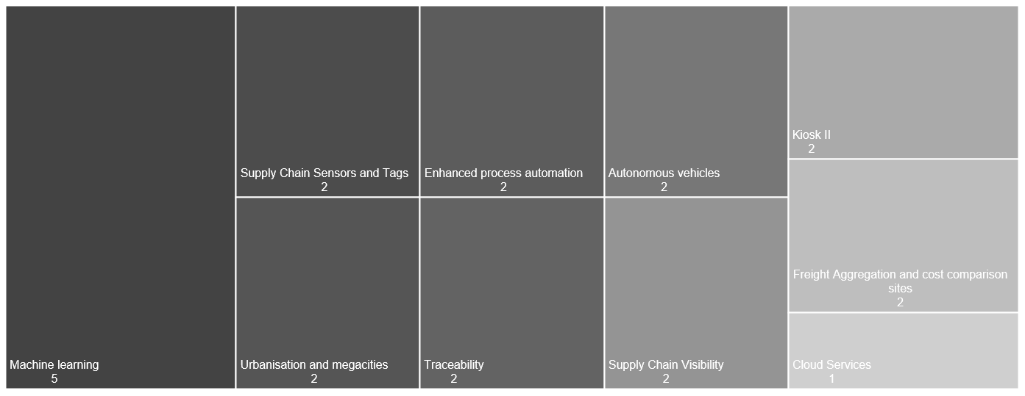
Top 10 trends within Innovation Agendas Travel & Transportation
Notes:
//count of disruptors for an industry
match (i:Industry)--(si:SubIndustry)--( a:Account)--(ia:InnovationAgenda)--(cvc:ClientValueChain)--(cd:ClientDisruptor)-[:SPECIALIZES]->(trend)
where i.name='Energy'
return trend.name, count(trend) order by count(trend) desc
limit 10

Slide 22
Demand Signals by Region

Slide 23
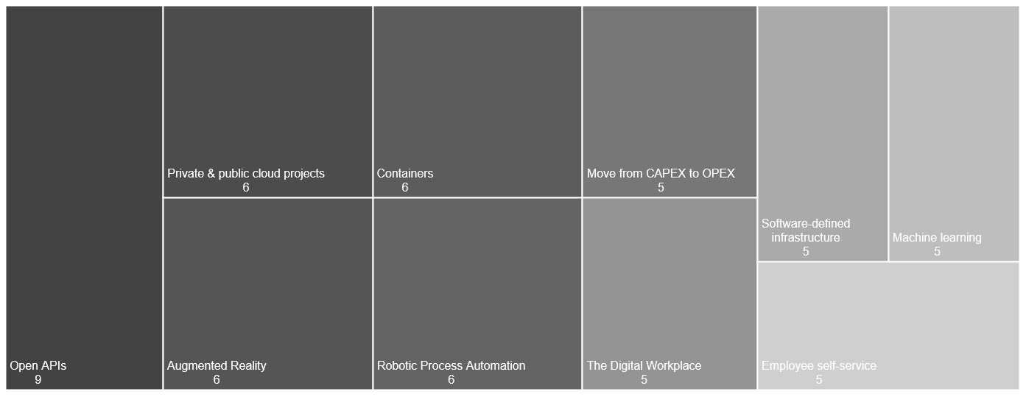
Top 10 trends within Innovation Agendas AMS
Notes:
//count of disruptors for a region
match (r:Region)--(a:Account)--(ia:InnovationAgenda)--(cvc:ClientValueChain)--(cd:ClientDisruptor)-[:SPECIALIZES]->(trend)
where r.name='AMS'
return trend.name, count(trend) order by count(trend) desc
LIMIT 10

Slide 24
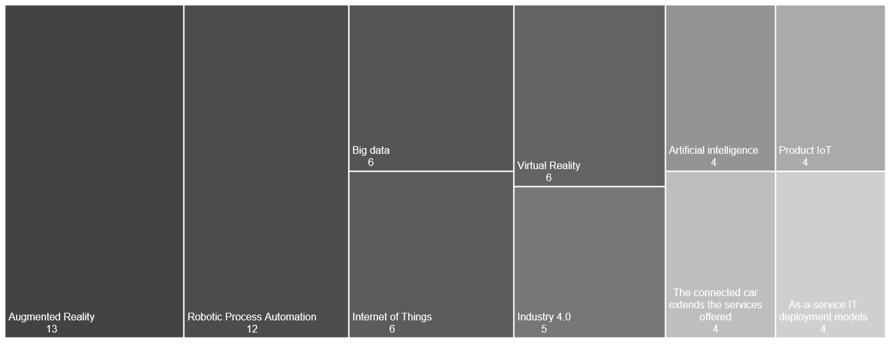
Top 10 trends within Innovation Agendas N & C Europe
Notes:
//count of disruptors for a region
match (r:Region)--(a:Account)--(ia:InnovationAgenda)--(cvc:ClientValueChain)--(cd:ClientDisruptor)-[:SPECIALIZES]->(trend)
where r.name='N & C Europe'
return trend.name, count(trend) order by count(trend) desc
LIMIT 10

Slide 25
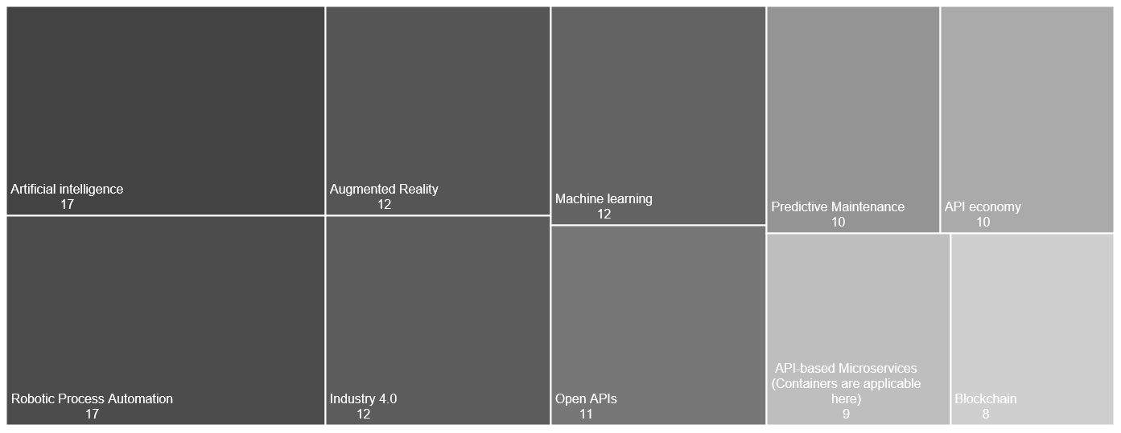
Top 10 trends within Innovation Agendas UKIIMEA
Notes:
//count of disruptors for a region
match (r:Region)--(a:Account)--(ia:InnovationAgenda)--(cvc:ClientValueChain)--(cd:ClientDisruptor)-[:SPECIALIZES]->(trend)
where r.name=‘UKIIMEA'
return trend.name, count(trend) order by count(trend) desc
LIMIT 10

Slide 26
Focus Areas by Industry

Slide 27
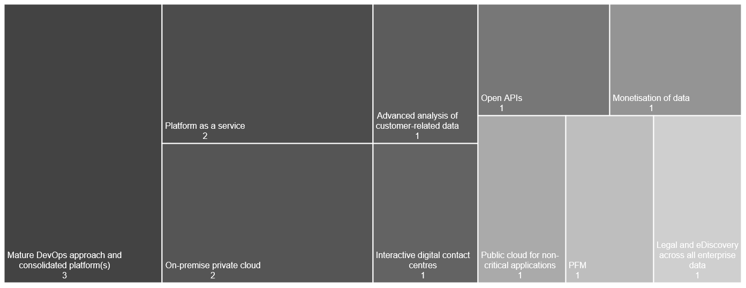
Top 10 focus areas within Innovation Agendas Banking & Capital Markets
Notes:
//count of disruptors for a region
match (i:Industry)--(si:SubIndustry)--(a:Account)--(ia:InnovationAgenda)--(cvc:ClientValueChain)--(cd:ClientDisruptor)-[:SPECIALIZES]->(trend)
where cd.focusArea = true and i.name="Banking & Capital Markets"
return trend.name, count(trend) order by count(trend) desc
LIMIT 10

Slide 28
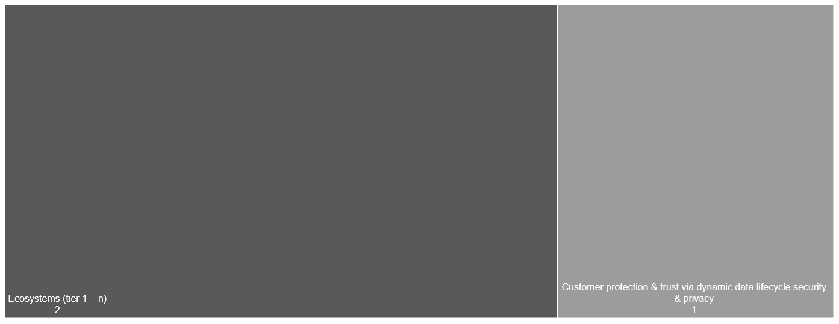
Top 10 focus areas within Innovation Agendas Communications, Media & Entertainment
Notes:
//count of disruptors for a region
match (i:Industry)--(si:SubIndustry)--(a:Account)--(ia:InnovationAgenda)--(cvc:ClientValueChain)--(cd:ClientDisruptor)-[:SPECIALIZES]->(trend)
where cd.focusArea = true and i.name="Communications, Media & Entertainment"
return trend.name, count(trend) order by count(trend) desc
LIMIT 10

Slide 29
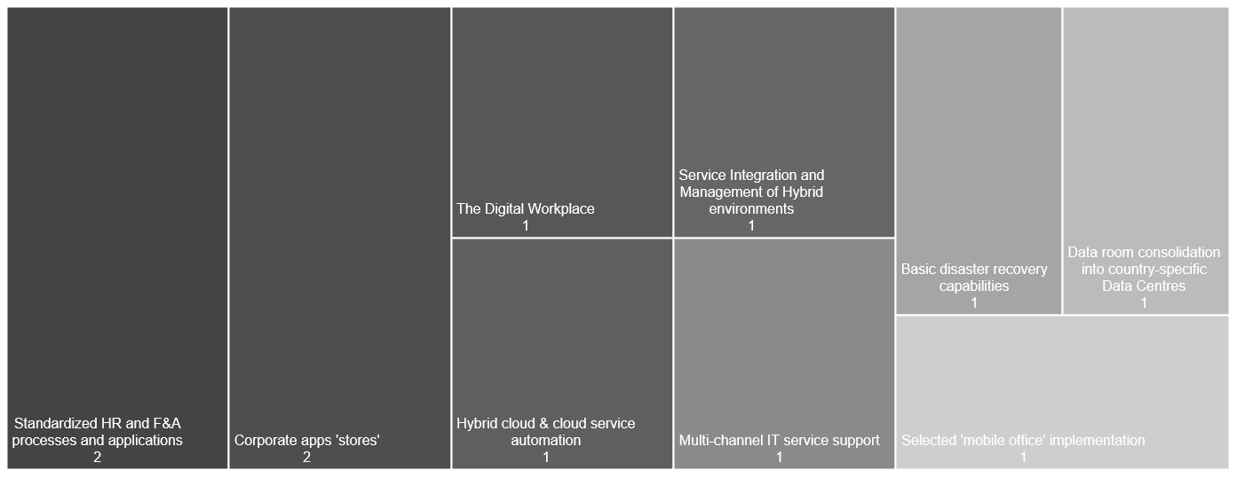
Top 10 focus areas within Innovation Agendas Consumer Industries & Retail
Notes:
//count of disruptors for a region
match (i:Industry)--(si:SubIndustry)--(a:Account)--(ia:InnovationAgenda)--(cvc:ClientValueChain)--(cd:ClientDisruptor)-[:SPECIALIZES]->(trend)
where cd.focusArea = true and i.name="Consumer Industries & Retail"
return trend.name, count(trend) order by count(trend) desc
LIMIT 10

Slide 30
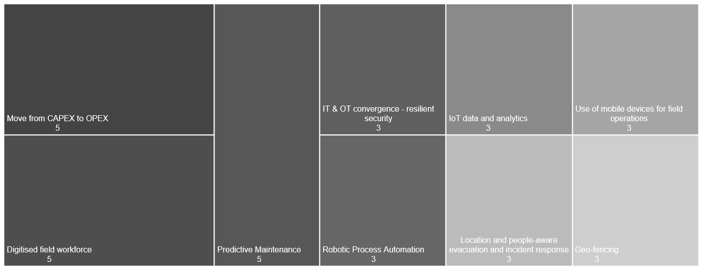
Top 10 focus areas within Innovation Agendas Energy
Notes:
//count of disruptors for a region
match (i:Industry)--(si:SubIndustry)--(a:Account)--(ia:InnovationAgenda)--(cvc:ClientValueChain)--(cd:ClientDisruptor)-[:SPECIALIZES]->(trend)
where cd.focusArea = true and i.name="Energy"
return trend.name, count(trend) order by count(trend) desc
LIMIT 10

Slide 31
Top 10 focus areas within Innovation Agendas Healthcare & Life Sciences
NO DATA
Notes:
//count of disruptors for a region
match (i:Industry)--(si:SubIndustry)--(a:Account)--(ia:InnovationAgenda)--(cvc:ClientValueChain)--(cd:ClientDisruptor)-[:SPECIALIZES]->(trend)
where cd.focusArea = true and i.name="Healthcare & Life Sciences"
return trend.name, count(trend) order by count(trend) desc
LIMIT 10

Slide 32
Top 10 focus areas within Innovation Agendas Insurance
NO DATA
Notes:
//count of disruptors for a region
match (i:Industry)--(si:SubIndustry)--(a:Account)--(ia:InnovationAgenda)--(cvc:ClientValueChain)--(cd:ClientDisruptor)-[:SPECIALIZES]->(trend)
where cd.focusArea = true and i.name="Healthcare & Life Sciences"
return trend.name, count(trend) order by count(trend) desc
LIMIT 10

Slide 33
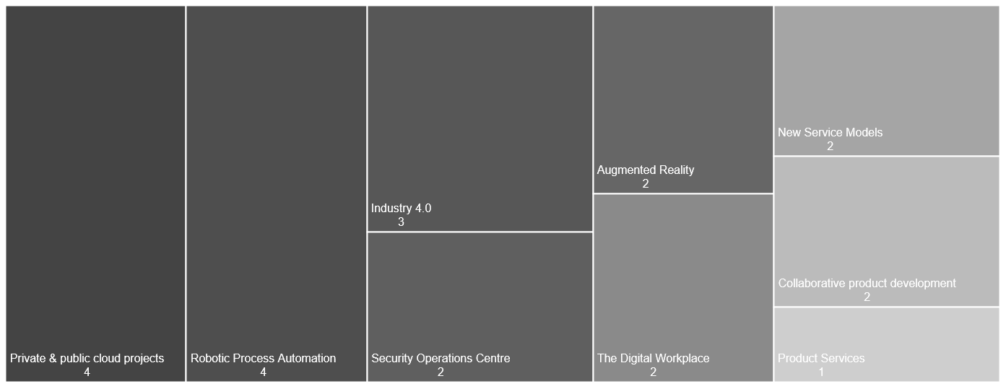
Top 10 focus areas within Innovation Agendas Manufacturing
Notes:
//count of disruptors for a region
match (i:Industry)--(si:SubIndustry)--(a:Account)--(ia:InnovationAgenda)--(cvc:ClientValueChain)--(cd:ClientDisruptor)-[:SPECIALIZES]->(trend)
where cd.focusArea = true and i.name="Manufacturing"
return trend.name, count(trend) order by count(trend) desc
LIMIT 10

Slide 34
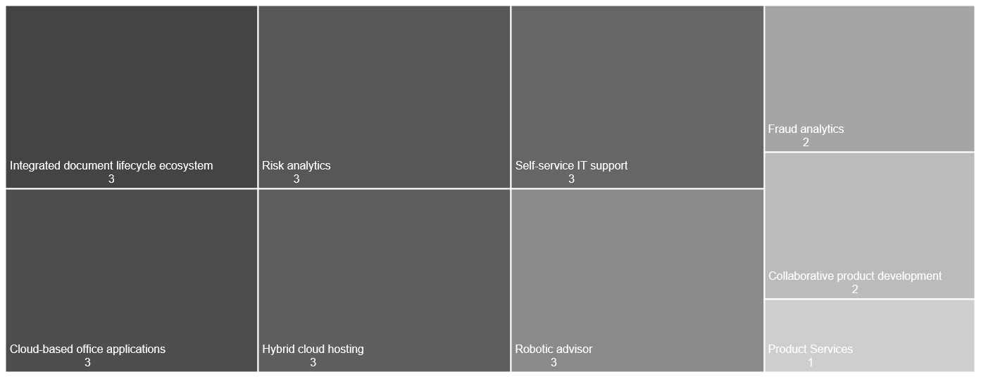
Top 10 focus areas within Innovation Agendas Public Sector
Notes:
//count of disruptors for a region
match (i:Industry)--(si:SubIndustry)--(a:Account)--(ia:InnovationAgenda)--(cvc:ClientValueChain)--(cd:ClientDisruptor)-[:SPECIALIZES]->(trend)
where cd.focusArea = true and i.name="Public Sector"
return trend.name, count(trend) order by count(trend) desc
LIMIT 10

Slide 35
Top 10 focus areas within Innovation Agendas Travel & Transportation
NO DATA
Notes:
//count of disruptors for a region
match (i:Industry)--(si:SubIndustry)--(a:Account)--(ia:InnovationAgenda)--(cvc:ClientValueChain)--(cd:ClientDisruptor)-[:SPECIALIZES]->(trend)
where cd.focusArea = true and i.name="Travel & Transportation"
return trend.name, count(trend) order by count(trend) desc
LIMIT 10

Slide 36
Focus Areas by Region

Slide 37
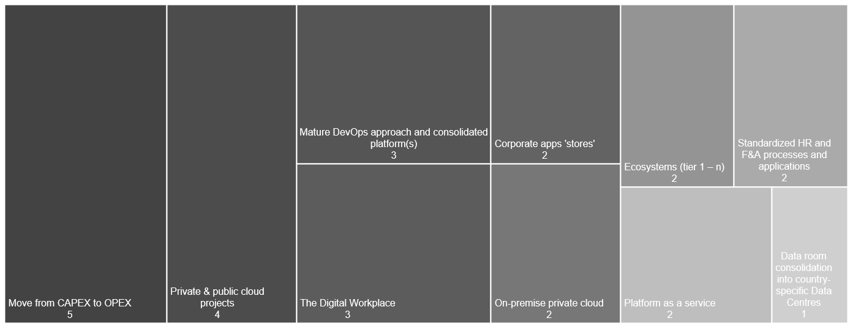
Top 10 focus areas within Innovation Agendas AMS
Notes:
//count of disruptors for a region
match (r:Region)--(a:Account)--(ia:InnovationAgenda)--(cvc:ClientValueChain)--(cd:ClientDisruptor)-[:SPECIALIZES]->(trend)
where cd.focusArea = true and r.name=“AMS"
return trend.name, count(trend) order by count(trend) desc
LIMIT 10

Slide 38
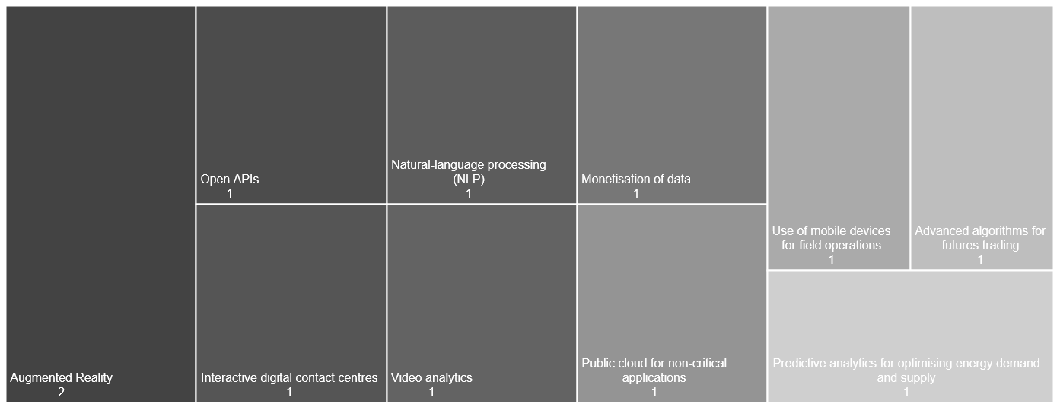
Top 10 focus areas within Innovation Agendas N & C Europe
Notes:
//count of disruptors for a region
match (r:Region)--(a:Account)--(ia:InnovationAgenda)--(cvc:ClientValueChain)--(cd:ClientDisruptor)-[:SPECIALIZES]->(trend)
where cd.focusArea = true and r.name="UKIIMEA"
return trend.name, count(trend) order by count(trend) desc
LIMIT 10

Slide 39
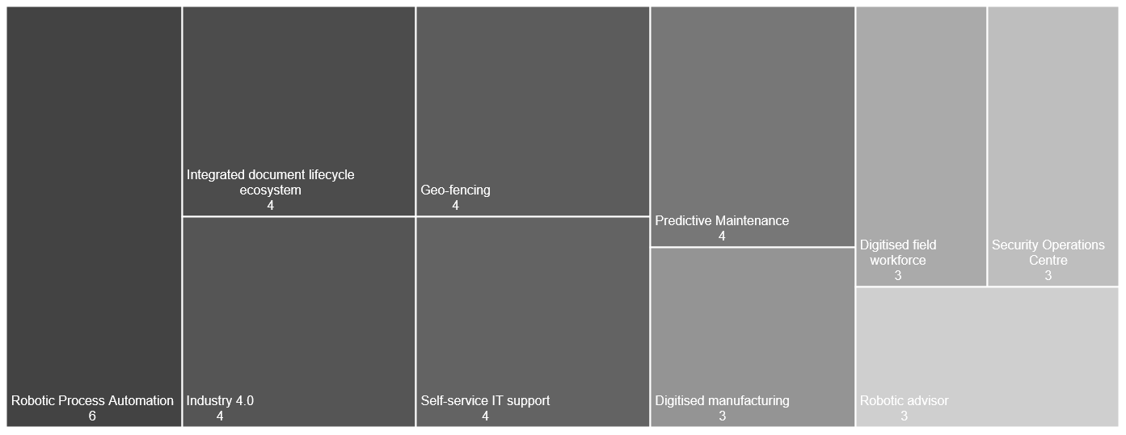
Top 10 focus areas within Innovation Agendas UKIIMEA
Notes:
//count of disruptors for a region
match (r:Region)--(a:Account)--(ia:InnovationAgenda)--(cvc:ClientValueChain)--(cd:ClientDisruptor)-[:SPECIALIZES]->(trend)
where cd.focusArea = true and r.name="UKIIMEA"
return trend.name, count(trend) order by count(trend) desc
LIMIT 10

Slide 40
Top trends within delivered solutions
Industry breakdown

Slide 41
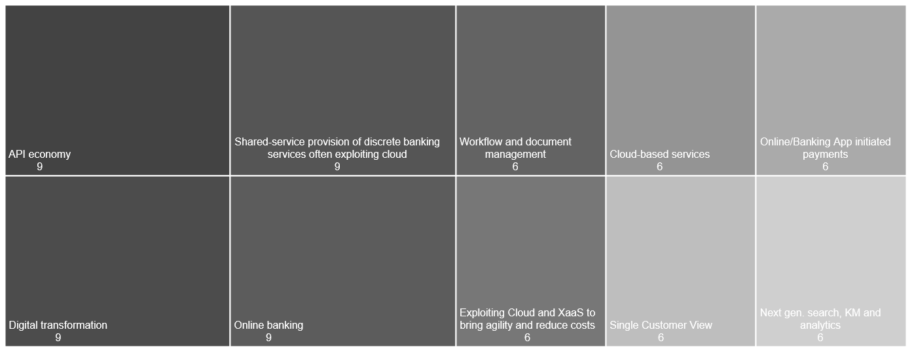
Top 10 trends within solutions Banking & Capital Markets
Notes:
match (trend)
where trend:BusinessTrend or trend:TechnologyTrend
with trend
match (trend)-[:INFLUENCE]-(s:Solution)--(si:SubIndustry)--(i:Industry)
where i.name="Banking & Capital Markets"
return distinct i.name, trend.name, count(trend) as counter order by counter DESC
limit 10

Slide 42
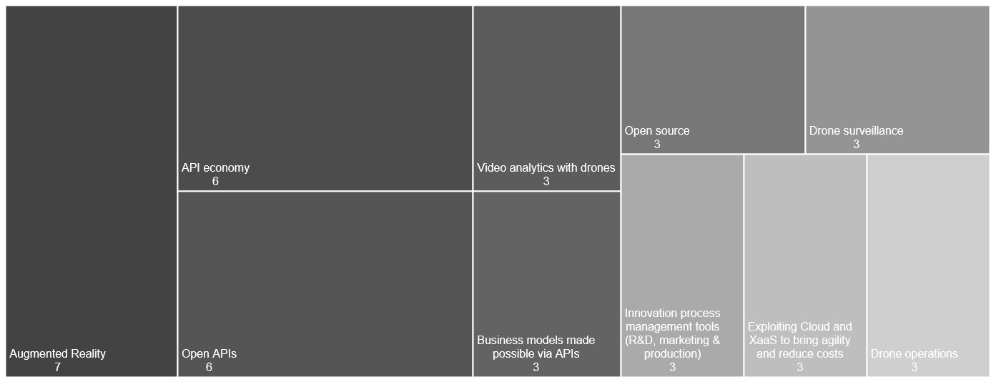
Top 10 trends within solutions Communications, Media & Entertainment
Notes:
match (trend)
where trend:BusinessTrend or trend:TechnologyTrend
with trend
match (trend)-[:INFLUENCE]-(s:Solution)--(si:SubIndustry)--(i:Industry)
where i.name="Communications, Media & Entertainment"
return distinct trend.name, count(trend) as counter order by counter DESC
limit 10

Slide 43
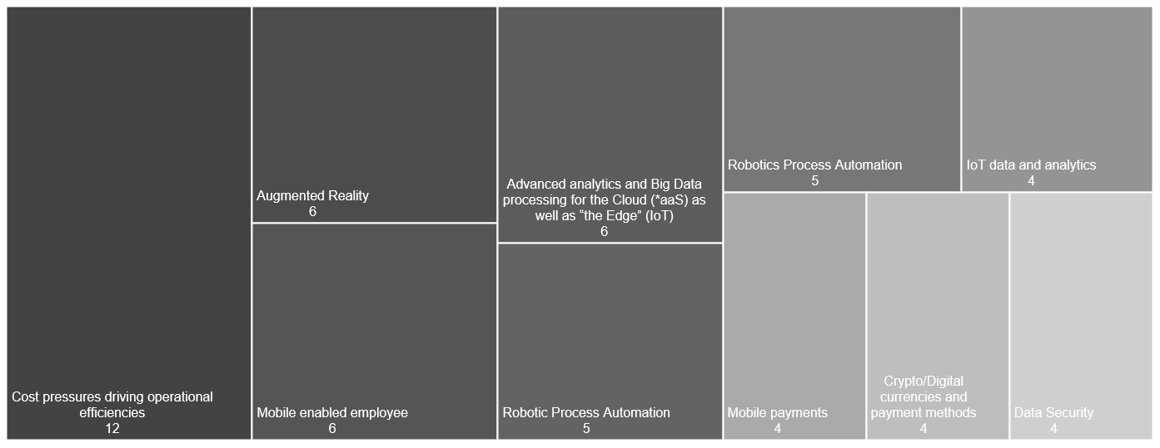
Top 10 trends within solutions Consumer Industries & Retail
Notes:
match (trend)
where trend:BusinessTrend or trend:TechnologyTrend
with trend
match (trend)-[:INFLUENCE]-(s:Solution)--(si:SubIndustry)--(i:Industry)
where i.name="Consumer Industries & Retail"
return distinct trend.name, count(trend) as counter order by counter DESC
limit 10

Slide 44
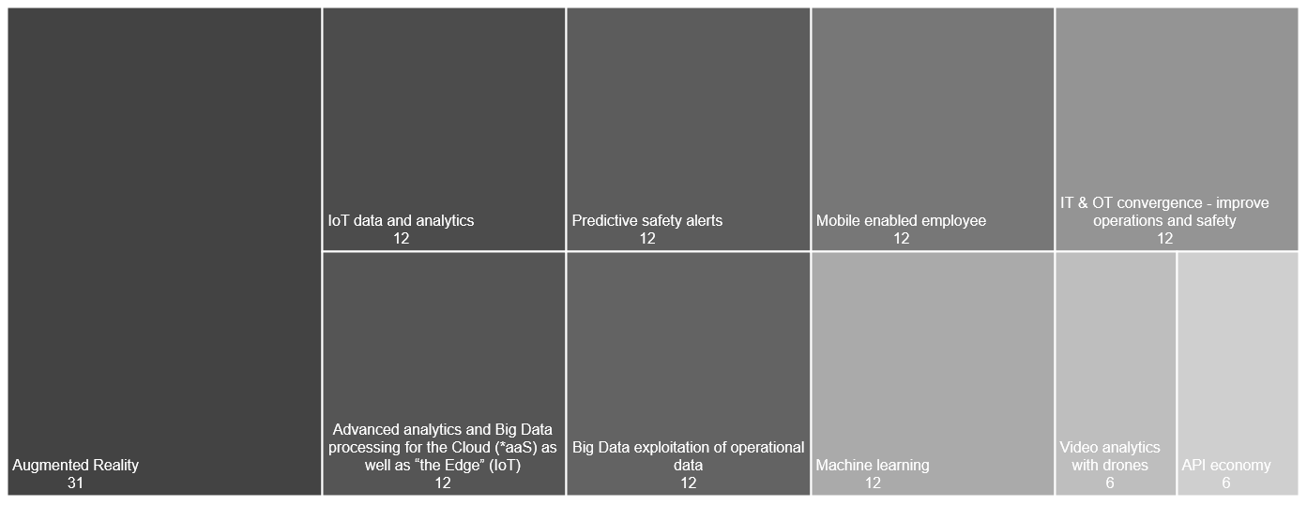
Top 10 trends within solutions Energy
Notes:
match (trend)
where trend:BusinessTrend or trend:TechnologyTrend
with trend
match (trend)-[:INFLUENCE]-(s:Solution)--(si:SubIndustry)--(i:Industry)
where i.name="Energy"
return distinct trend.name, count(trend) as counter order by counter DESC
limit 10

Slide 45
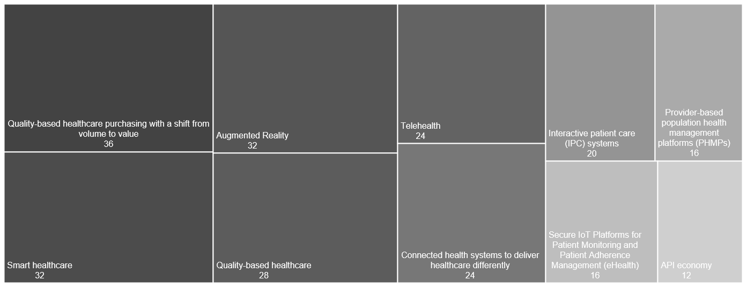
Top 10 trends within solutions Healthcare & Life Sciences
Notes:
match (trend)
where trend:BusinessTrend or trend:TechnologyTrend
with trend
match (trend)-[:INFLUENCE]-(s:Solution)--(si:SubIndustry)--(i:Industry)
where i.name="Healthcare & Life Sciences"
return distinct trend.name, count(trend) as counter order by counter DESC
limit 10

Slide 46
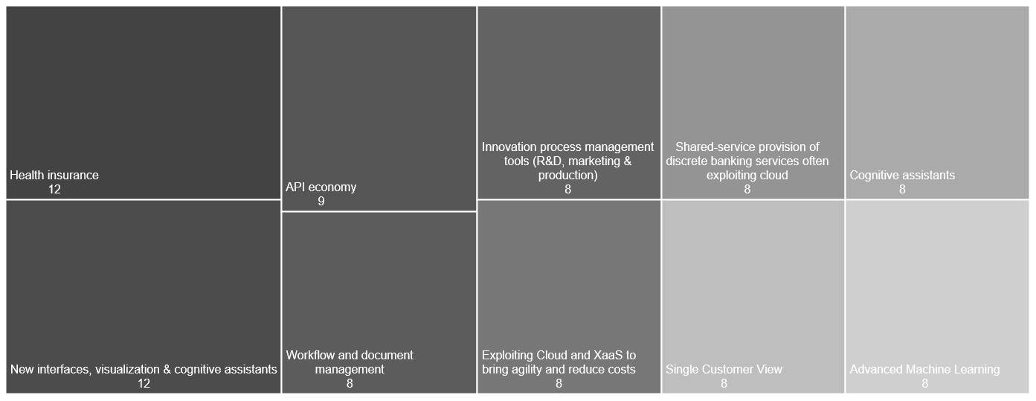
Top 10 trends within solutions Insurance
Notes:
match (trend)
where trend:BusinessTrend or trend:TechnologyTrend
with trend
match (trend)-[:INFLUENCE]-(s:Solution)--(si:SubIndustry)--(i:Industry)
where i.name="Insurance"
return distinct trend.name, count(trend) as counter order by counter DESC
limit 10

Slide 47
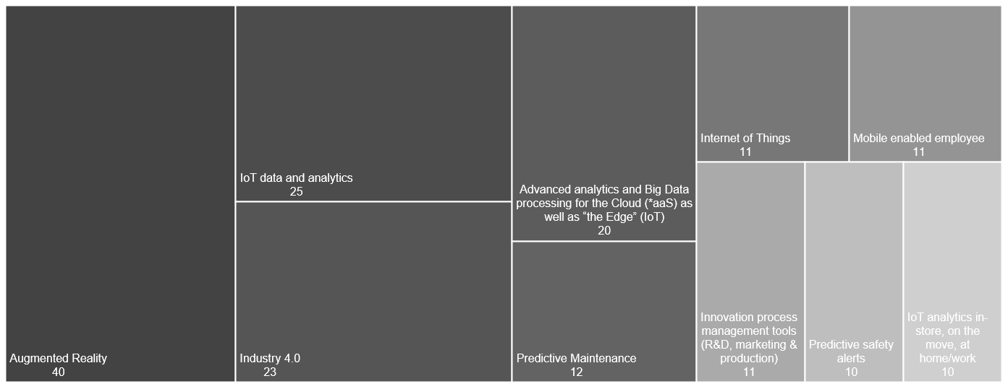
Top 10 trends within solutions Manufacturing
Notes:
match (trend)
where trend:BusinessTrend or trend:TechnologyTrend
with trend
match (trend)-[:INFLUENCE]-(s:Solution)--(si:SubIndustry)--(i:Industry)
where i.name="Manufacturing"
return distinct trend.name, count(trend) as counter order by counter DESC
limit 10

Slide 48
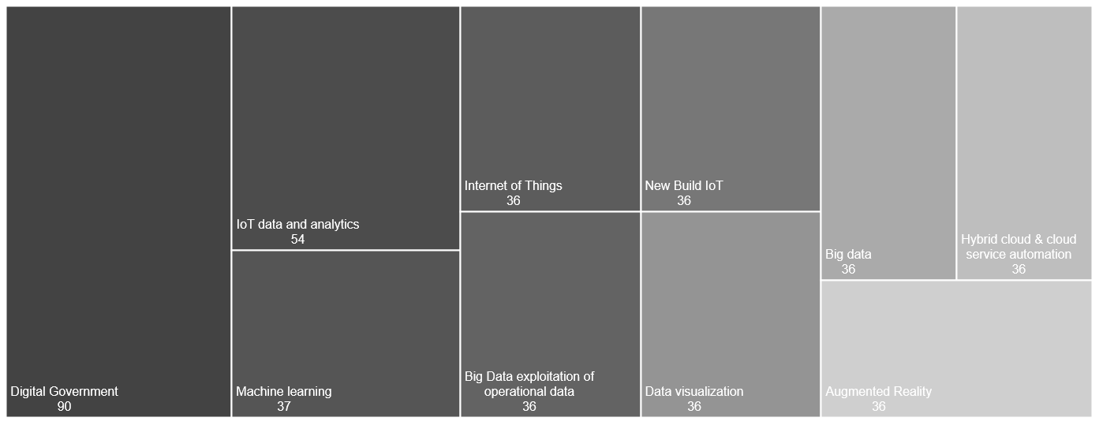
Top 10 trends within solutions Public Sector
Notes:
match (trend)
where trend:BusinessTrend or trend:TechnologyTrend
with trend
match (trend)-[:INFLUENCE]-(s:Solution)--(si:SubIndustry)--(i:Industry)
where i.name="Public Sector"
return distinct trend.name, count(trend) as counter order by counter DESC
limit 10

Slide 49
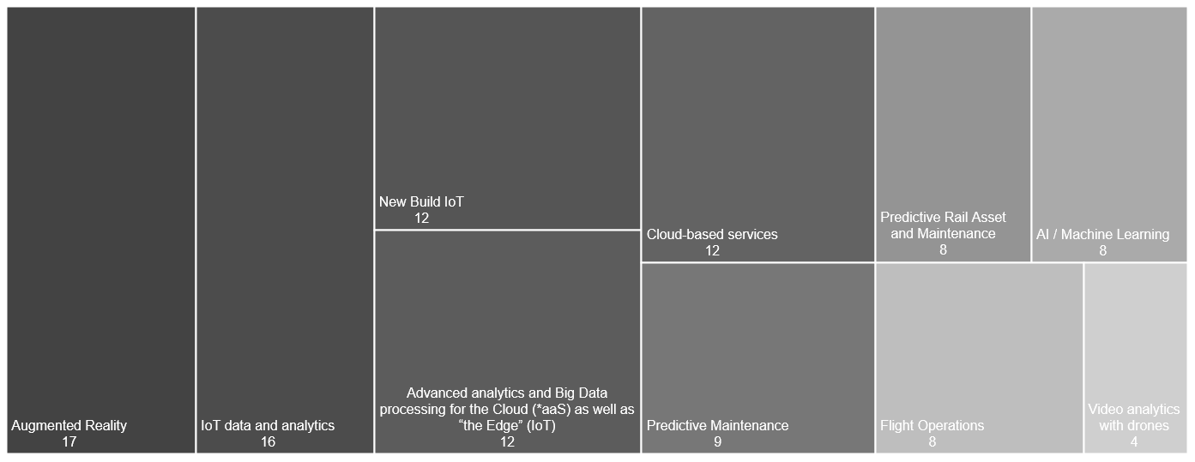
Top 10 trends within solutions Travel & Transportation
Notes:
match (trend)
where trend:BusinessTrend or trend:TechnologyTrend
with trend
match (trend)-[:INFLUENCE]-(s:Solution)--(si:SubIndustry)--(i:Industry)
where i.name="Travel & Transportation"
return distinct trend.name, count(trend) as counter order by counter DESC
limit 10

Slide 50
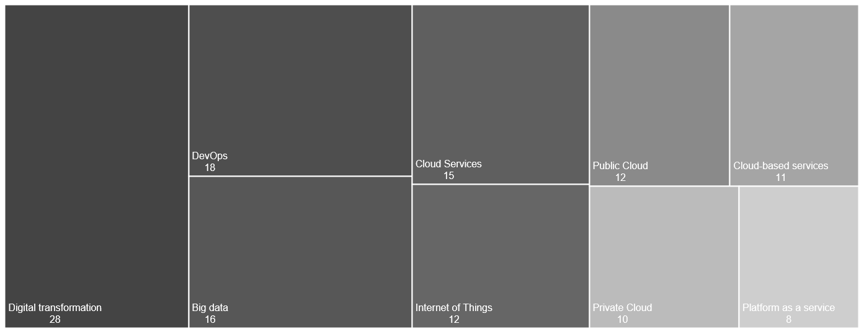
Top 10 trends within solutions Pan Industry
Notes:
match (trend)
where trend:BusinessTrend or trend:TechnologyTrend
with trend
match (trend)-[:INFLUENCE]-(s:Solution)--(si:SubIndustry)--(i:Industry)
where i.name="Travel & Transportation"
return distinct trend.name, count(trend) as counter order by counter DESC
limit 10

